Slide 1
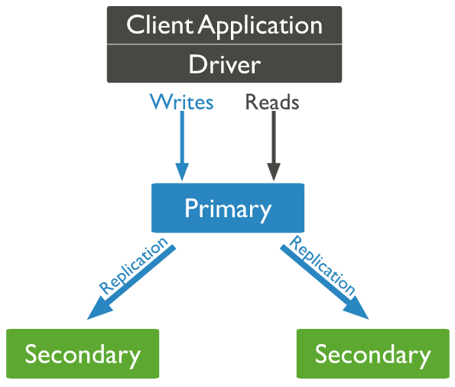

Understanding Replication Architecture
The primary records all changes to its data sets in its operation log.
Secondaries replicate the primary's oplog and apply the operations to their data sets asynchronously.
Oplog(Operation log)

